Slide 1
Predict the fuel burnt (kg)
PRC Data Challenge 2025 -> https://ansperformance.eu/study/data-challenge/dc2025/
October – November 2025
Team details:
Our team name is : understated-zucchini
Our submission bucket is : prc-2025-understated-zucchini

Slide 2
Main principle
Feed the model with Fuel Flow Kg/Seconds (instead of fuel Kilograms)
Compute the Fuel Flow from Fuel (kg) between Fuel Start Instant and Fuel End Instant
Before submitting the ranking/final results , revert predicted fuel flow
From fuel flow in Kg/Seconds to fuel consumption in Kg
Explanation : it is easier to compare delta values and find the dependent variables contribution than it would be with an absolute value (strongly related to a delta time frame, delta between fuel start and fuel end instants

Slide 3
Data Model
Wind Data
Flight Data
Flight id
Fuel Start vs Flight Timestamp
Latitude longitude altitude
timestamp
Fuel End vs Flight Timestamp
Fuel Data
origin airport ICAO code
destination airport ICAO code
Airport Data
Flight id
Flight List Data
Aircraft Data
Aircraft ICAO code

Slide 4
Principles
Read Fuel Train records
compute time difference seconds = fuel record end – fuel record start
Compute fuel flow kg per seconds = fuel kg / ( fuel record end – fuel record start )
Link to Flight List using the flight id
Compute fuel burn relative start = fuel burnt start – takeoff (from the related flight list)
Compute fuel burn relative end = fuel burnt end – takeoff (from the related flight list)
Extend fuel records with attributes coming from the flight list
Add origin longitude, origin latitude, origin_elevation
Add destination longitude, destination latitude, destination elevation
Add flight distance Nautical Miles and flight duration seconds

Slide 5
Process steps
Compute missing trajectories with missing lat long altitudes
Compute missing TAS and CAS from mach (no interpolation)
Use wind data to compute TAS from track and ground speed
Interpolate Train, Rank, Final flight data files – reduce missing features
Build unique Fuel data frame with extended featues
Concatenate Train and Rank fuel dataframes before launching Tensor Flow

Slide 6
Airports

Slide 7
Airports sanity checks
Ensure that all airports (origin and destination) found in the flight list files are available in the airports database
Solution -> concat list of airports (origin and destination) from all the 3 flight list files, suppress duplicates and ensure that all airports ICAO code are available in the airports database
Ensure that each of these airports, as available in the airports database has latitude, longitude and elevation with valid values
Valid values for latitude and longitude are their nominal ranges
Elevation must be a real number (not a number is an error)

Slide 8
Airports data sanity checks
Airport ZGOW Jieyang Chaoshan International Airport has a missing “elevation ft”
Status as of

Slide 9
Airports data sanity checks
Icao code not empty and length > 0
Latitude in the range -90,0 and + 90,0
Longitude in the range -180 and +180,0
Elevation in feet > 0,0 feet
Elevation in feet * feet_to_meters < 5000,0 meters
Notes:
airport ICAO = ZUDR --> elevation = 14108.0 feet--> elevation = 4300.1184 meters
airport ICAO = ZX and UPL --> elevation = 13943.0 feet --> elevation = 4249.8264 meters

Slide 10
airports lat/lon and aircraft lat/lon
Latitude:
Values range from -90° to +90°.
Lines of latitude run east-west and are parallel to each other.
The equator is at 0° latitude.
Longitude:
Values range from -180° to +180°.
Lines of longitude run north-south and converge at the poles.
The prime meridian (0° longitude) runs through Greenwich, England. These ranges define the geographic coordinate system used to specify locations on Earth.

Slide 11
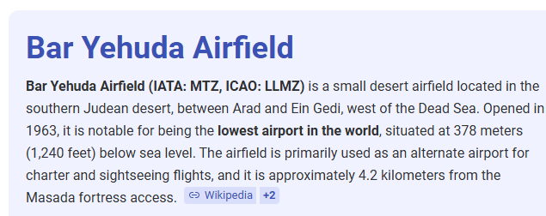
Airports data sanity checks
airport ICAO = LLMZ --> elevation (feet) = -1266.0 --> elevation meters = -385.8768

Slide 12
Flight Lists

Slide 13
Flight list – sanity checks
Example for Java code
Assert (takeoff() != null )
Assert (takeoff().getEpochSecond() > 0)
Assert (landed() != null)
Asser (landed().getEpochSecond() > 0)
Assert landed().isAfter(takeoff())

Slide 14
Set takeoff and landing date type as UTC Compute flight distance compute flight duration Extract year from takeoff Extract month from takeoff Extract day of the year (1..365) from takeoff Compute distance (great circle using haversine method) between departure and arrival airports compute flight duration between takeoff and landing -> Principles is to get rid of absolute datetime convert lat long into sine and cosine -> favorize model analysis because of discontinuity from -180 degrees to 0 degrees and avoid scaling only absolute degrees
Extend Flight list records

Slide 15
Extend Flight list records
Suppress airport names
Compute distance (Nautical miles) between departure and arrival airport
Convert all Date Time instant to UTC
Compute flight time between flight takeoff and flight landed
Use time difference for all instant versus flight takeoff
From flight date
extract year and month
Compute day number in the current year (range 1 to 365)
Suppress absolute dates as they are replaced by relative ones from takeoff instant

Slide 16
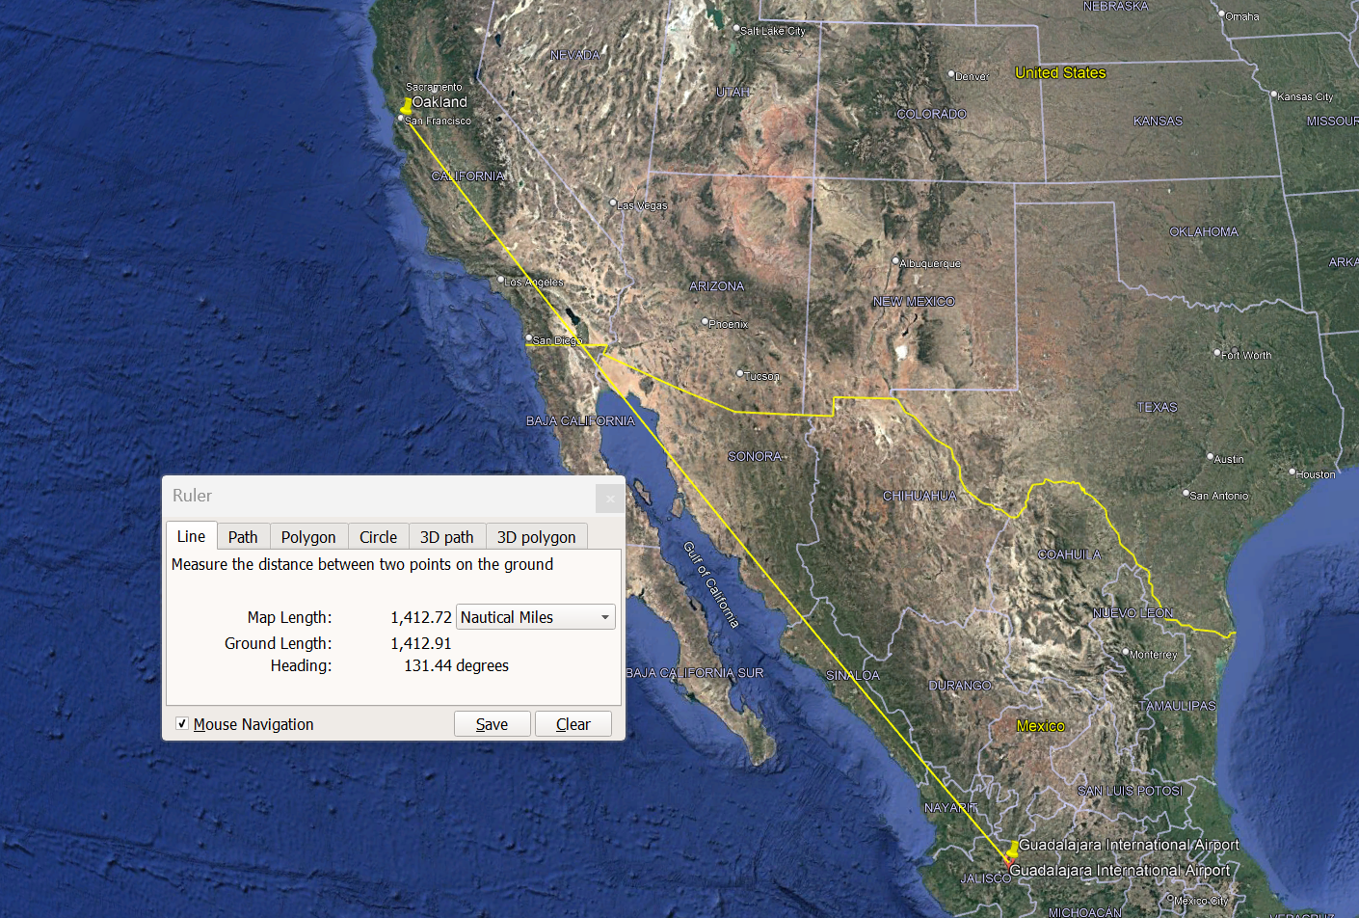
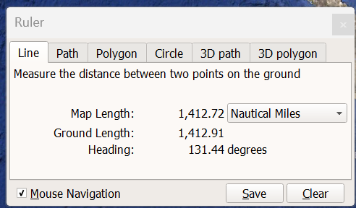
Check great circle distance (in nautical miles)
origin_icao | origin_name | destination_icao | destination_name | flight_distance_Nautical miles
MMGL | Guadalajara International Airport | KOAK | Oakland International Airport | 1427.58
Oakland
Guadalajara

Slide 17
Aircrafts

Slide 18
Aircrafts data
File obtained from FAA site
FAA-Aircraft-Char-DB-AC-150-5300-13B-App-2023-09-07.xlsx
https://www.kaggle.com/datasets/huynhtruc109/aircraft-faa
Contains 2 interesting columns that may be signals / differenciators for the fuel consumption
Wingspan_ft_without_winglets_sharklets
Wingspan_ft_with_winglets_sharklets

Slide 19
Aircrafts features
Option 3 -> use both
3 options ->
option one -> use one hot encoder / getDummies to add as much aircraft ICAO codes in both train and rank and use 0 or 1 to encode the aircraft
Option two -> do not use hot encoder / getDummies and provide additional features to characterize the aircraft
int Num_Engines, float Approach_Speed_knot, float Wingspan_ft_without_winglets_sharklets, float Wingspan_ft_with_winglets_sharklets,
float Length_ft, float Tail_Height_at_OEW_ft, float Wheelbase_ft, float Cockpit_to_Main_Gear_ft, float Main_Gear_Width_ft,
// Maximum take off weight -> double MTOW_lb, double MTOW_kg,
// Maximum landing weight -> double MALW_lb, double MALW_kg,
float Parking_Area_ft2

Slide 20
Aircrafts in rank and final
PRC Aircrafts in Rank and Final
A20N
A21N
A306
A319
A320
A321
A332
A333
A359
B38M
B734
B737
B738
B739
B744
B752
B763
B772
B77L
B77W
B788
B789
Use this list of aircrafts in Rank and Final to reduce the train dataset

Slide 21
Fuel

Slide 22
fuel absolute datetime instant
Compute relative duration in seconds from the “flight” takeoff instant
Fuel Start Instant (UTC) – absolute instant (not very useful for the model)
converted to duration from the “takeoff”UTC Instant
Converted to duration until the “landed” UTC instant
Fuel End Instant (UTC) – absolute instant (not very useful for the model)
converted to duration from the “takeoff” UTC Instant
Converted to duration until the “landed” UTC instant

Slide 23
Fuel data injected into flight data
In order to prepare for interpolation, fuel start and fuel end of the same flight_id are inserted in the flight data of the same flight_id

Slide 24
Flights

Slide 25
flight data files with holes / missing values in latitude, longitude or altitude
There are “hundreds” of Train files with at least one missing value in Latitude, Longitude or Altitude

Slide 26
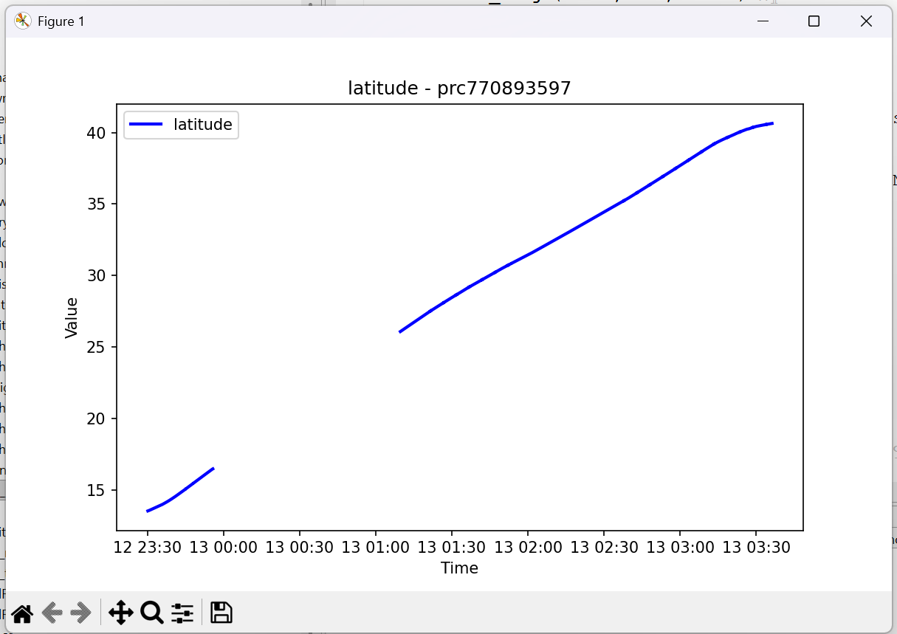
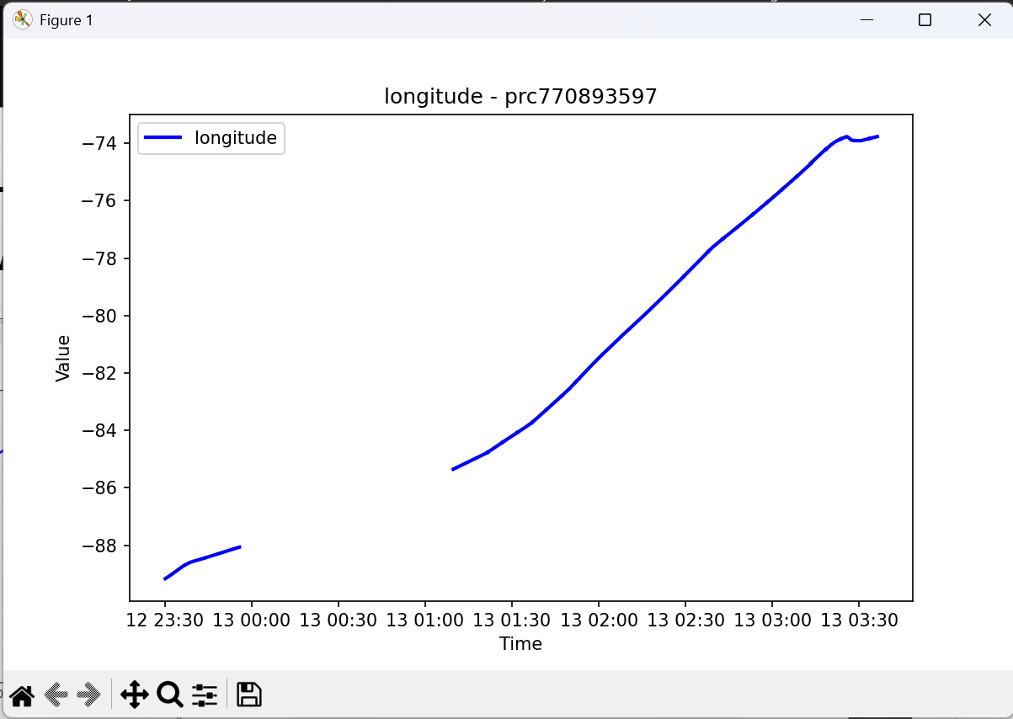
Erroneous <<train>> flight data

Slide 27
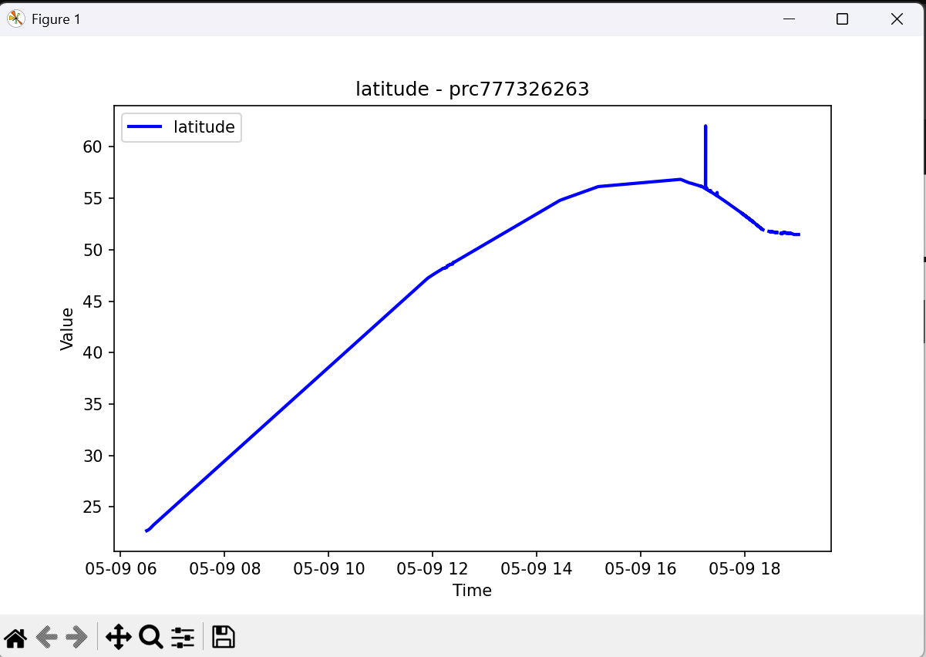
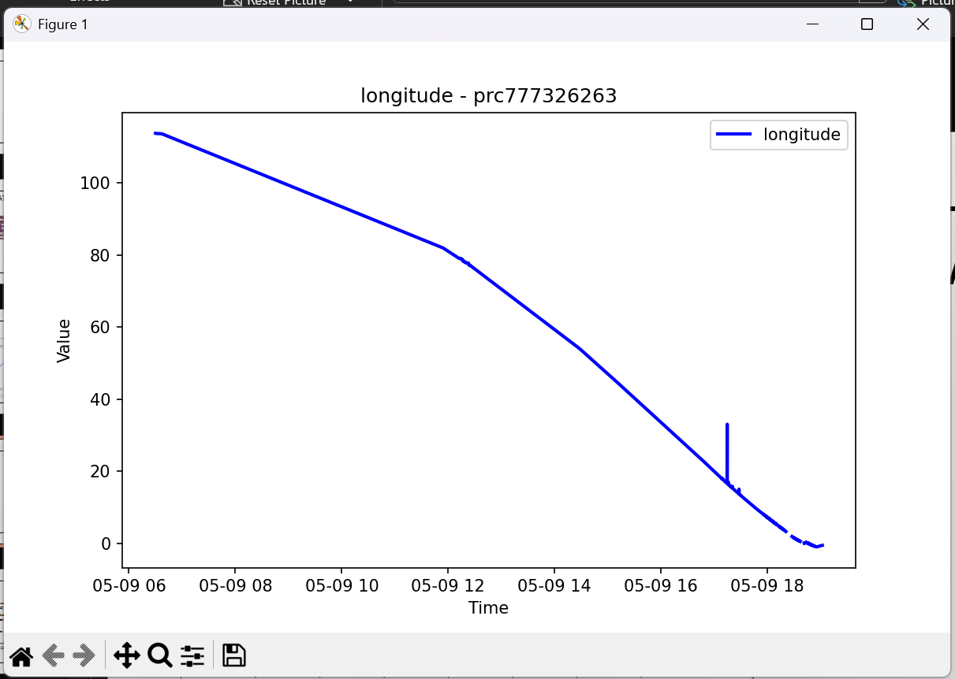
Erroneous <<train>> flight data

Slide 28
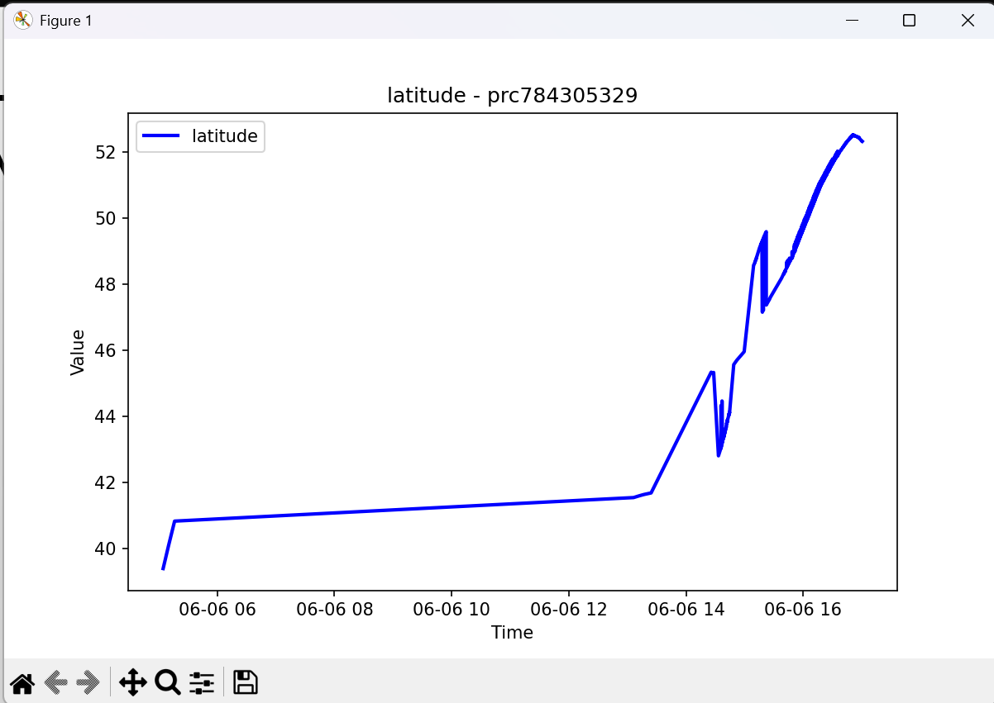
Erroneous <<train>> flight data

Slide 29

Feature engineering heading-track-and-radial
Heading. The direction in which the longitudinal axis of an aircraft is pointed, usually expressed in degrees from North (true, magnetic, compass or grid). (Source: ICAO)
Track. The projection on the earth’s surface of the path of an aircraft, the direction of which path at any point is usually expressed in degrees from North (true, magnetic or grid). (Source: ICAO)
Radial. A magnetic bearing extending from a VOR/VORTAC/TACAN. (Source: UK CAA)
Bearing. The horizontal direction to or from any point, usually measured clockwise from true north, magnetic north, or some other reference point through 360 degrees. (Source: US FAA)

Slide 30
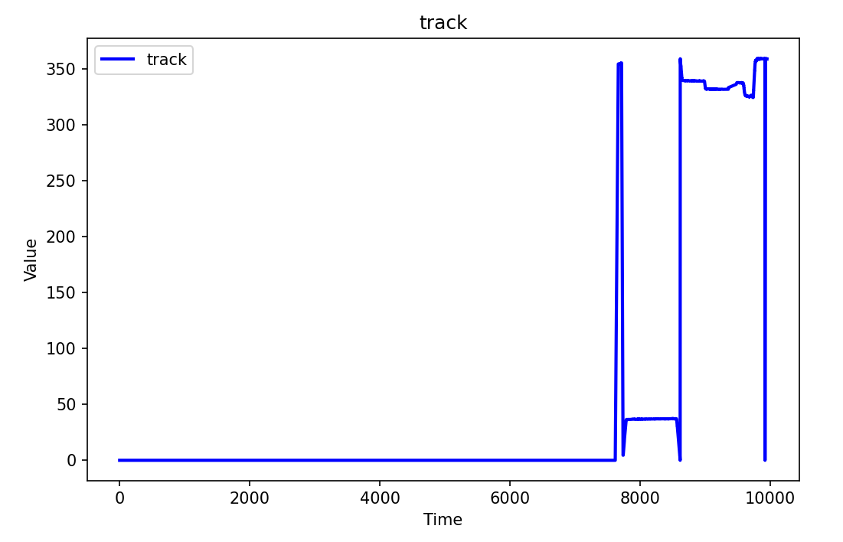
Feature engineering of track angles
The track angle is given in Decimal degrees
Angles in the range 0 degrees to 360 degrees are not good inputs to the models
Because 360° et 0° must be near and avoid discontinuity when moving from 360 degrees to 0 degrees.
To avoid discontinuity
Compute sinus and cosinus of each angles
In radians before feeding the model
During interpolation use modulo 360…
For the track angle compute a vector
from the ground speed

Slide 31
Combine ground speed and track angle
Mais la donnée « aircraft track angle » sera plus facile à interpréter pour le modèle si vous convertissez les colonnes de direction et de vitesse de l’avion en un vecteur vitesse
import numpy as np
''' convert track angles from degrees to radians '''
track_radians = df.pop('track')* np.pi / 180
groundSpeedMax = df['groundspeed'].max()
groundSpeed = df.pop('groundspeed')
# Calculate the aircraft speed x and y components.
df['groundspeed_x'] = groundSpeed * np.cos(track_radians)
df['groundspeed_y'] = groundSpeed * np.sin(track_radians)

Slide 32
aircraft flight position at fuel start and fuel end
Compute each aircraft interpolated position at fuel start and fuel end
Use Latitude Longitude of interpolated aircraft position to compute
For each fuel start Instant compute
Haversine distance Nm from aircraft position to departure/origin airport
Haversine distance Nm from aircraft position to arrival/destination airport
For each fuel end Instant compute
Haversine distance Nm from aircraft position to departure/origin airport
Haversine distance Nm from aircraft position to arrival/destination airport

Slide 33
Flight data cleaning
Example -> training flight prc770822360 contains duplicated timestamps
org.apache.commons.math3.exception.NonMonotonicSequenceException: les points 12 et 13 ne sont pas strictement croissants (1 744 474 640 >= 1 744 474 640)

Slide 34
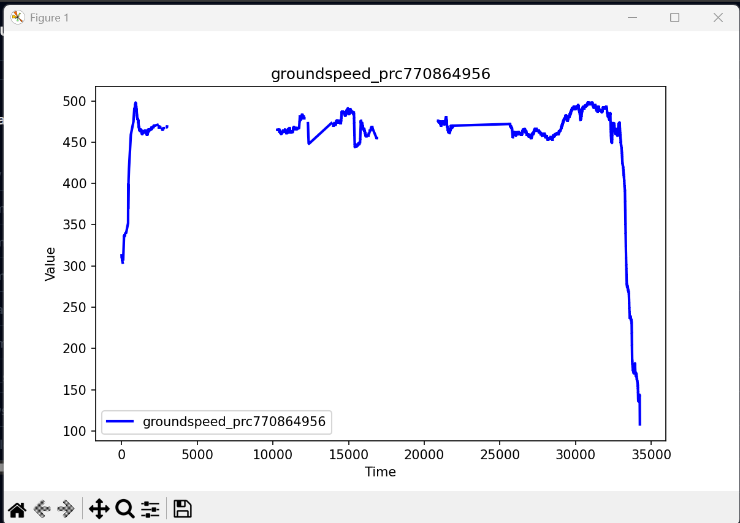
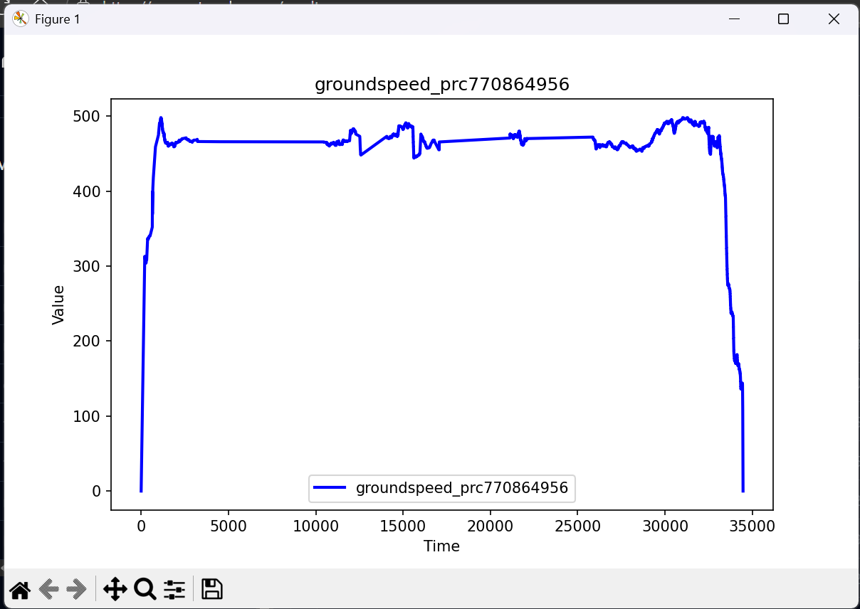
Interpolation -> Groundspeed
Due to insertion of takeoff “pseudo” series
Due to insertion of landed “pseudo” series

Slide 35
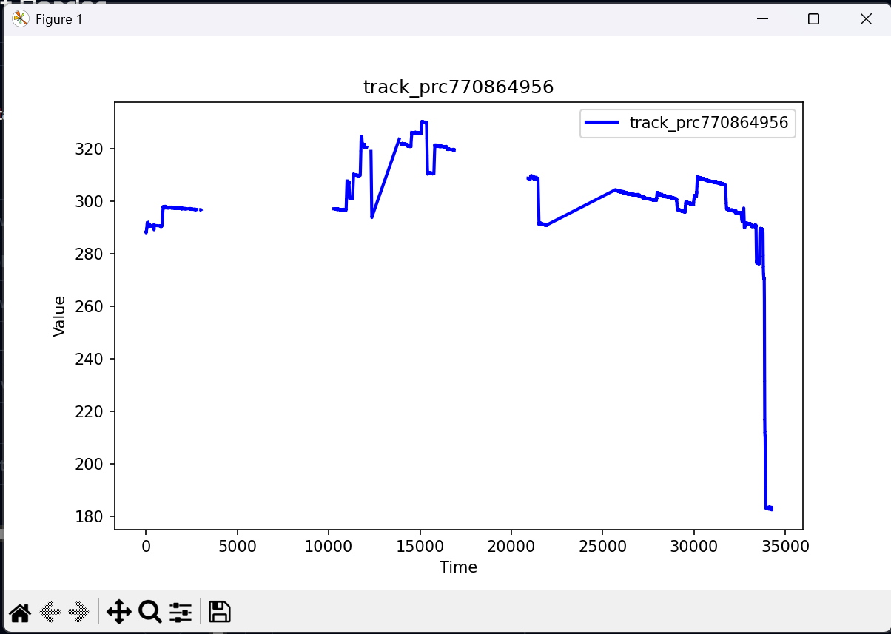
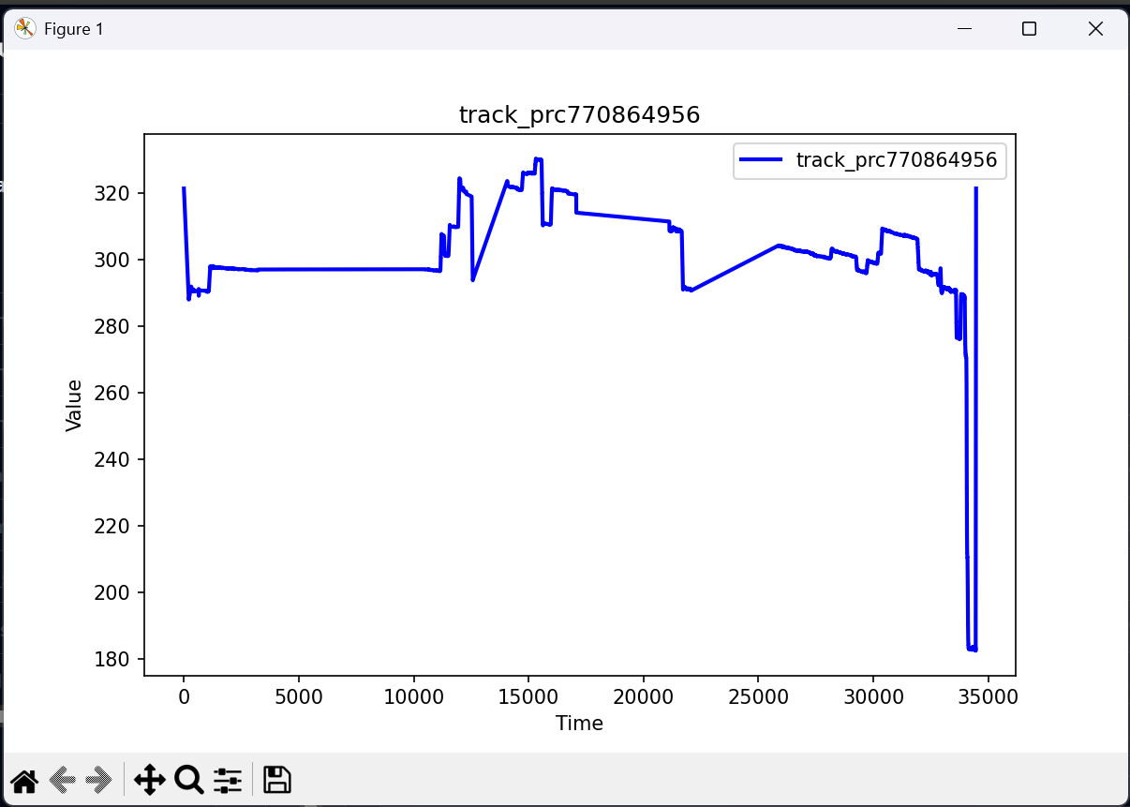
Interpolation -> track angle
Consequences of insertion of heading angle from origin to destination
At takeoff and at landed (first and last timestamp in augmented flight data
Track angles must be constrained using modulo 360,0 degrees

Slide 36
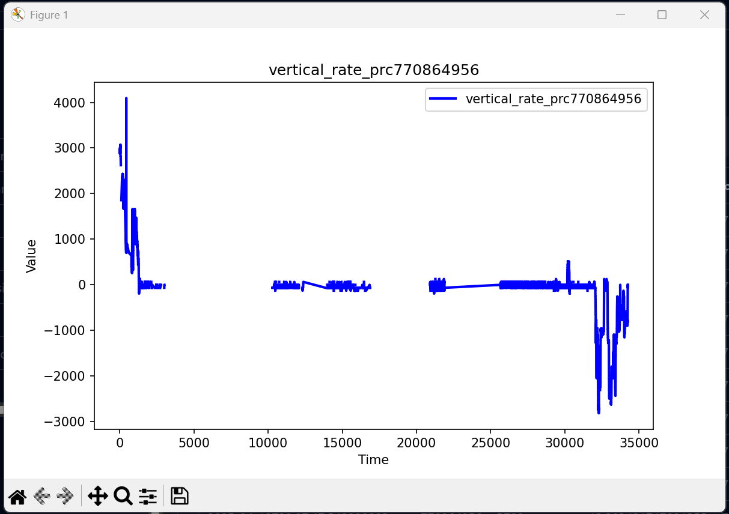
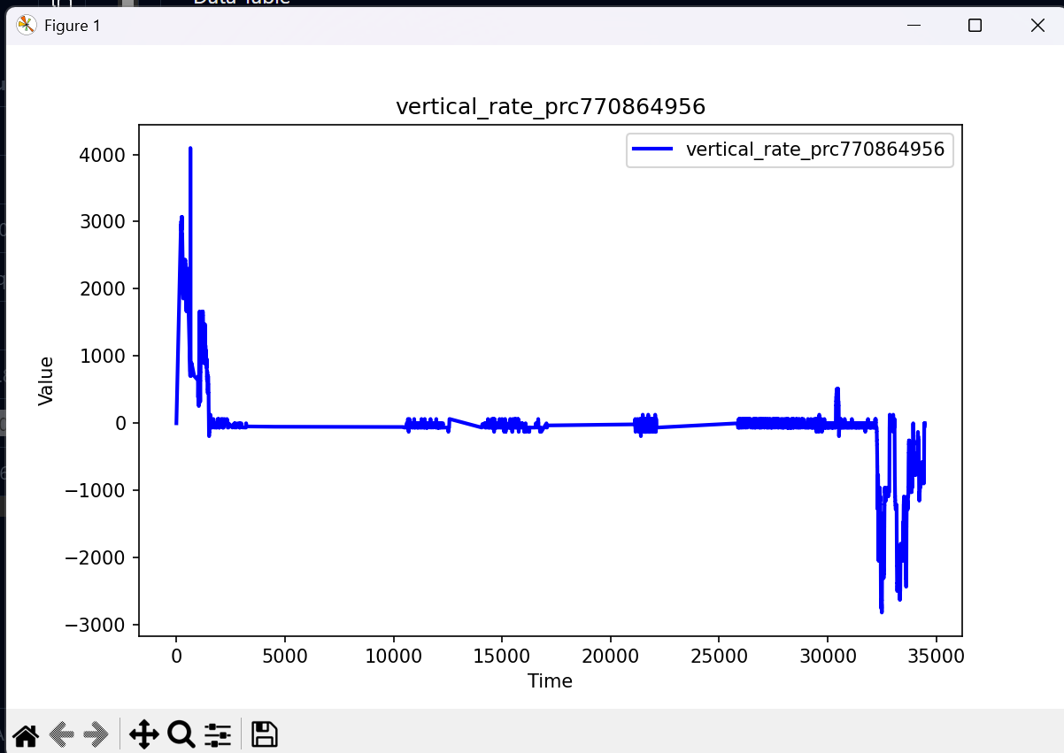
Interpolation -> vertical rate

Slide 37
Training versus Validation loss

Slide 38
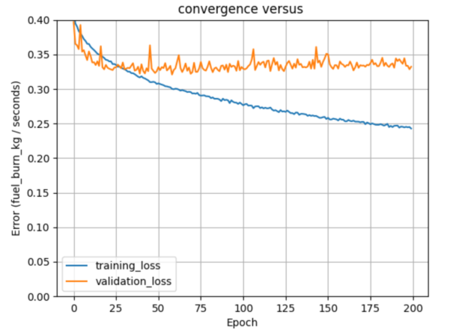
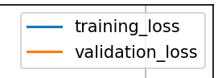
Training versus Validation loss
16 october 2025
Y = fuel flow kg per seconds
All train records
133984 train fuel records
11085 train flight files
Make the val_loss as low as possible

Slide 39
Do not
You do not need to scale the Y of train data as the algorithm or model will set the parameter values to get least Cost (error), that is k {Y (output)-Y (original)} anyway.

Slide 40
25 October 2025
Input to the modeling
Train-> ['time_diff_seconds', 'fuel_flow_kg_sec', 'aircraft_latitude_at_fuel_start', 'aircraft_longitude_at_fuel_start', 'aircraft_latitude_at_fuel_end', 'aircraft_longitude_at_fuel_end', 'aircraft_distance_flown_Nm', 'aircraft_altitude_ft_at_fuel_start', 'aircraft_altitude_ft_at_fuel_end', 'aircraft_computed_vertical_rate_ft_min', 'aircraft_groundspeed_kt_at_fuel_start', 'aircraft_groundspeed_kt_at_fuel_end', 'aircraft_track_angle_deg_at_fuel_start', 'aircraft_track_angle_deg_at_fuel_end', 'aircraft_vertical_rate_ft_min_at_fuel_start', 'aircraft_vertical_rate_ft_min_at_fuel_end', 'origin_elevation_feet', 'destination_elevation_feet', 'flight_distance_Nm', 'flight_duration_sec’]
Rank -> ['time_diff_seconds', 'aircraft_latitude_at_fuel_start', 'aircraft_longitude_at_fuel_start', 'aircraft_latitude_at_fuel_end', 'aircraft_longitude_at_fuel_end', 'aircraft_distance_flown_Nm', 'aircraft_altitude_ft_at_fuel_start', 'aircraft_altitude_ft_at_fuel_end', 'aircraft_computed_vertical_rate_ft_min', 'aircraft_groundspeed_kt_at_fuel_start', 'aircraft_groundspeed_kt_at_fuel_end', 'aircraft_track_angle_deg_at_fuel_start', 'aircraft_track_angle_deg_at_fuel_end', 'aircraft_vertical_rate_ft_min_at_fuel_start', 'aircraft_vertical_rate_ft_min_at_fuel_end', 'origin_elevation_feet', 'destination_elevation_feet', 'flight_distance_Nm', 'flight_duration_sec']

Slide 41
missing
Date of the flight -> year, month, day in the year
Fuel burn relative start to takeoff
Fuel burn relative end to takeoff
Fuel burn relative end to landed
Mach
CAS
TAS
Aircrafts data

Slide 42
steps
Read fuel records
Extend each fuel record with flight data
Scale and encode aircraft icao code
Read Flight list records
Extend fuel records with flight list data
Y column is fuel flow kg per seconds
Compute fuel flow kg per seconds
Encode aircraft_icao_code
Scale all columns
Compute flight distance (Nm)
Compute flight duration (seconds)
Use fuel start end relative stamp to link with flight record timestamp
Timestamp inside start – end of fuel record

Slide 43
Flight file with issues
Parquet file <<C:\Users\rober\git\PRCdataChallenge2025\Data-Download-OpenSkyNetwork\competition-rank-data\prc806717600.parquet>

Slide 44

Fundamental concepts of regression
Definition of Regression
Regression estimates relationships between dependent and independent variables to understand their connection.
Predicting Continuous Outcomes
The goal of regression is to predict continuous variables based on input data from other variables.
Understanding Variable Influence
Regression helps identify how independent variables influence the dependent variable in a measurable way.
Notes:
--- Regression involves estimating the relationship between dependent and independent variables. We aim to predict continuous outcomes and understand how variables influence each other. Image source: Microsoft 365 content library

Slide 45

Types of regression problems
Linear Regression
Linear regression models the relationship between variables using a straight line for simple, direct trends.
Polynomial Regression
Polynomial regression handles complex data by fitting a curved line to capture non-linear relationships.
Logistic Regression
Logistic regression models probabilities for classification problems using an S-shaped logistic curve.
Notes:
--- Common regression types include linear, polynomial, and logistic regression. Each type addresses different data patterns and modelling needs, from simple linear relationships to complex non-linear dependencies. Image source: Microsoft 365 content library

Slide 46

Advantages of TensorFlow for regression tasks
Scalable Model Building
TensorFlow supports scalable construction of regression models suitable for various data sizes and complexities.
Data Pipeline Integration
TensorFlow easily integrates with diverse data pipelines ensuring smooth data flow for regression tasks.
Robust Training and Evaluation
TensorFlow offers comprehensive tools for training, evaluation, and optimisation of regression models.
Notes:
--- TensorFlow provides scalable model building, easy integration with data pipelines, and robust tools for training and evaluation, facilitating effective regression modelling. Image source: Microsoft 365 content library

Slide 47

Preparing data for TensorFlow regression
Data Cleaning
Removing errors and inconsistencies from data is essential for accurate regression model training.
Data Normalisation
Normalising data scales values to a common range, improving model convergence and performance.
Training and Testing Split
Splitting data into training and testing sets helps evaluate model accuracy and avoid overfitting.
Notes:
--- Data preparation includes cleaning, normalising, and splitting data into training and testing sets to ensure the model learns effectively without bias. Image source: Microsoft 365 content library

Slide 48

Building a linear regression model
Model Structure
Linear regression uses layers to connect input features with output predictions clearly and efficiently.
Weight Optimization
Weights are adjusted during training to minimise prediction errors and improve model accuracy.
Notes:
--- A linear regression model in TensorFlow is built using layers to represent input features and output predictions, with weights optimised during training to minimise errors. Image source: Microsoft 365 content library

Slide 49

Training, evaluation, and interpretation
Model Training Process
Training involves feeding data through the model and adjusting its parameters to improve performance.
Evaluation Metrics
Evaluation metrics like mean squared error measure the model's accuracy and performance.
Model Interpretation
Interpretation helps understand insights from the model to explain its predictions and behaviour.
Notes:
--- Training involves feeding data through the model and adjusting parameters. Evaluation metrics like mean squared error assess performance, while interpretation helps understand model insights. Image source: Microsoft 365 content library

Slide 50

Handling non-linear regression with neural networks
Neural Networks Structure
Neural networks use multiple stacked layers to capture complex non-linear relationships in data.
Activation Functions
Activation functions introduce non-linearity, enabling neural networks to model varied data patterns beyond linear regression.
Advanced Regression Modeling
Neural networks extend regression capabilities by effectively handling complex, non-linear data relationships.
Notes:
--- Neural networks in TensorFlow can model complex non-linear relationships by stacking layers and using activation functions, expanding regression capabilities beyond linear patterns. Image source: Microsoft 365 content library

Slide 51

Preventing overfitting and improving model performance
Regularisation Techniques
Regularisation adds penalty terms to reduce model complexity and prevent overfitting in training.
Dropout Method
Dropout randomly disables neurons during training to improve model generalisation and reduce overfitting.
Early Stopping Strategy
Early stopping halts training when validation performance declines, avoiding overfitting on training data.
Notes:
--- Techniques like regularisation, dropout, and early stopping help prevent overfitting, ensuring the model generalises well to new data and maintains predictive accuracy. Image source: Microsoft 365 content library

Slide 52
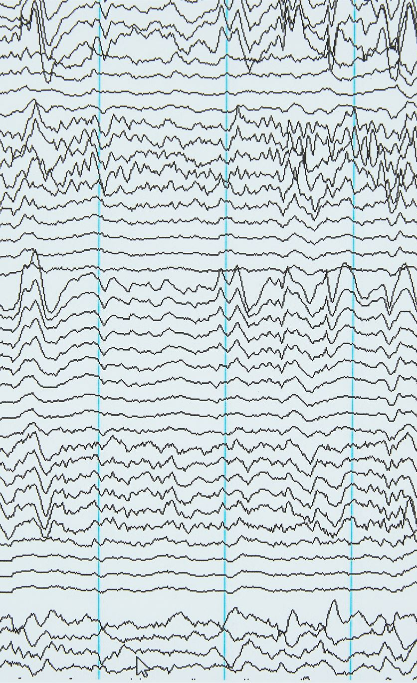
Visualising and interpreting results
Loss Curves Insight
Loss curves help track model performance over training, revealing convergence or overfitting trends.
Regression Plot Utility
Regression plots illustrate relationships between variables, helping interpret model predictions and fit quality.
Residual Analysis Importance
Residual analysis exposes model errors and biases, supporting diagnosis and improvement.
Notes:
--- Visual tools like loss curves, regression plots, and residual analysis aid in understanding model behaviour, diagnosing issues, and communicating results effectively. Image source: Microsoft 365 content library

Slide 53
Conclusion
Versatile Platform
TensorFlow offers a flexible platform supporting various regression analysis techniques for diverse applications.
Comprehensive Tools
The platform provides comprehensive tools enabling both foundational and advanced regression modelling.
Powerful Predictive Solutions
Applying TensorFlow’s techniques unlocks powerful predictive solutions across multiple domains and industries.
Notes:
TensorFlow is a versatile platform that empowers effective regression analysis through comprehensive tools and flexible modelling. Applying foundational and advanced techniques unlocks powerful predictive solutions across domains.

